Slide 1

Enterprise Integration Pattern (EIP) Session 2 Message Channels
Ayman El-Shayeb, Specialist in Egypt Center
Feb 13, 2016
Notes:
This is a sample Title Slide with Picture ideal for including a dark picture with a brief title and subtitle.
A selection of pre-approved title slides are available in the HPE Title Slide Library. The location of the library will be communicated later.
To insert a slide with a different picture from the HPE Title Slide Library:
Open the file HPE_16x9_Title_Slide_Library.pptx
From the Slide thumbnails pane, select the slide with the picture you would like to use in your presentation and click Copy (Ctrl+C)
Open a copy of the new HPE 16x9 template (Standard or Events) or your current presentation
In the Slide thumbnails pane, click Paste (Ctrl+V)
A Paste Options clipboard icon will appear. Click the icon and select Keep Source Formatting. (Ctrl+K)

Slide 2
EIP (Message Channels)
Quick review
Point to Point channel
Publish/Subscriber channel
Datatype Channel
Invalid Message Channel
Dead Letter Channel
Guaranteed Delivery
Channel Adapter
Message bridge
Message Bus

Slide 3
Integration
“Enterprise integration is the task of making separate applications work together to produce a unified set of functionality.”
Integration is not Designing N-Tier distributed applications

Slide 4
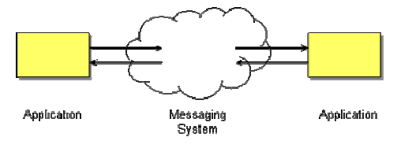
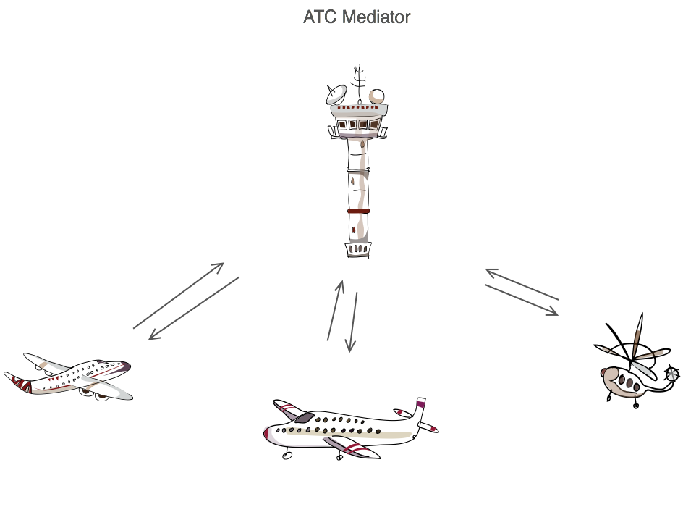
Messaging System
Messaging capabilities are typically provided by a separate software system called a messaging system or message-oriented middleware (MOM).
Messaging System receives, delivers, routes transfers and manage the messages.
Messaging system decouples the sender and receiver.
Applications are connected Asynchronously
Messaging System acts like mediator in GOF Mediation Design Pattern.
Notes:
This is a sample Picture with Caption slide ideal for including a picture with a brief descriptive statement.
To Replace the Picture on this Sample Slide (this applies to all slides in this template that contain replaceable pictures)
Select the sample picture and press Delete. Click the icon inside the shape to open the Insert Picture dialog box. Navigate to the location where the picture is stored, select desired picture and click on the Insert button to fit the image proportionally within the shape.
Note: Do not right-click the image to change the picture inside the picture placeholder. This will change the frame size of the picture placeholder. Instead, follow the steps outlined above.
Tip: use the Crop tool to reposition a picture within a placeholder. From the Picture Tools Format tab on the ribbon, click the Crop button. Click and drag the picture within the placeholder to reposition. To scale the picture within the placeholder (while Crop is active), grab a round corner handle and drag to resize. Hold Shift key to constrain picture aspect ratio when resizing.

Slide 5


Message
Any data that is to be transmitted via a messaging system must be converted into one or more messages that can be sent through messaging channels.
Sender and receiver should marshal and un-marsal the data into/ from one or more massage
Message contains Header and body.
Like real postal mail . Body carries payload (mail) and header (envelop) contains information important to message system
9 EIP related to Message constructions ( Command Message, Document Message, Event Message, Request-Reply, Return Address, Correlation Identifier, Message Sequence, Message Expiration, Format Indicator)
Package the information into a Message, a data record that the messaging system can transmit through a message channel.
Notes:
This is a sample Picture with Caption slide ideal for including a picture with a brief descriptive statement.
To Replace the Picture on this Sample Slide (this applies to all slides in this template that contain replaceable pictures)
Select the sample picture and press Delete. Click the icon inside the shape to open the Insert Picture dialog box. Navigate to the location where the picture is stored, select desired picture and click on the Insert button to fit the image proportionally within the shape.
Note: Do not right-click the image to change the picture inside the picture placeholder. This will change the frame size of the picture placeholder. Instead, follow the steps outlined above.
Tip: use the Crop tool to reposition a picture within a placeholder. From the Picture Tools Format tab on the ribbon, click the Crop button. Click and drag the picture within the placeholder to reposition. To scale the picture within the placeholder (while Crop is active), grab a round corner handle and drag to resize. Hold Shift key to constrain picture aspect ratio when resizing.

Slide 6

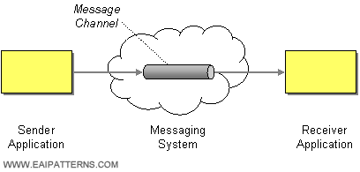
Message Channel
When an application has information to communicate, it doesn't just fling the information into the messaging system, it adds the information to a particular Message Channel. An application receiving information doesn't just pick it up at random from the messaging system; it retrieves the information from a particular Message Channel.
logical pipe to send messages
Receiver and sender don’t need to know each other . Both just send and receive from specific channel
Channel can be point to point or publish subscriber
Integration Developer should configure channels inside message system
9 EIP elements related to Message channels ( Point to point channel , Publish subscriber channel, Datatype Channel, Invalid Message Channel, Dead Letter Channel, Guaranteed Delivery, Channel Adapter, Messaging Bridge, Message Bus)
Connect the applications using a Message Channel, where one application writes information to the channel and the other one reads that information from the channel.
Notes:
This is a sample Picture with Caption slide ideal for including a picture with a brief descriptive statement.
To Replace the Picture on this Sample Slide (this applies to all slides in this template that contain replaceable pictures)
Select the sample picture and press Delete. Click the icon inside the shape to open the Insert Picture dialog box. Navigate to the location where the picture is stored, select desired picture and click on the Insert button to fit the image proportionally within the shape.
Note: Do not right-click the image to change the picture inside the picture placeholder. This will change the frame size of the picture placeholder. Instead, follow the steps outlined above.
Tip: use the Crop tool to reposition a picture within a placeholder. From the Picture Tools Format tab on the ribbon, click the Crop button. Click and drag the picture within the placeholder to reposition. To scale the picture within the placeholder (while Crop is active), grab a round corner handle and drag to resize. Hold Shift key to constrain picture aspect ratio when resizing.

Slide 7

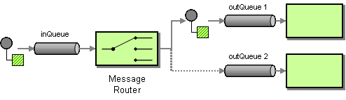
Message Router
One of responsibility of Messaging system is to route the messages between ( source and destination ) and between channels
Every Message type has certain path
Routing enable message system to reuse component.
Router can decide the destination based on content or other criteria like environment conditions
12 EIP for Router ( Content-Based Router, Message Filter, Dynamic Router, Recipient List, Splitter, Aggregator, Resequencer, Composed Message Processor, Scatter-Gather, Routing Slip, Process Manager, Message Broker)
Insert a special filter, a Message Router, which consumes a Message from one Message Channel and republishes it to a different Message Channel depending on a set of conditions.
Notes:
This is a sample Picture with Caption slide ideal for including a picture with a brief descriptive statement.
To Replace the Picture on this Sample Slide (this applies to all slides in this template that contain replaceable pictures)
Select the sample picture and press Delete. Click the icon inside the shape to open the Insert Picture dialog box. Navigate to the location where the picture is stored, select desired picture and click on the Insert button to fit the image proportionally within the shape.
Note: Do not right-click the image to change the picture inside the picture placeholder. This will change the frame size of the picture placeholder. Instead, follow the steps outlined above.
Tip: use the Crop tool to reposition a picture within a placeholder. From the Picture Tools Format tab on the ribbon, click the Crop button. Click and drag the picture within the placeholder to reposition. To scale the picture within the placeholder (while Crop is active), grab a round corner handle and drag to resize. Hold Shift key to constrain picture aspect ratio when resizing.

Slide 8

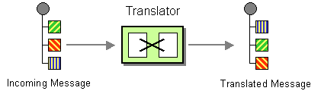
Message Translator
Message is routed between different systems . Each of them has different data model. Messaging system should translate messages to decouple systems.
Translator is similar to Adaptor design pattern
Translator is main component for decoupling
6 EIP related to Translator ( Envelope Wrapper, Content Enricher, Content Filter, Claim Check, Normalizer, Canonical Data Model)
Use a special filter, a Message Translator, between other filters or applications to translate one data format into another.
Notes:
This is a sample Picture with Caption slide ideal for including a picture with a brief descriptive statement.
To Replace the Picture on this Sample Slide (this applies to all slides in this template that contain replaceable pictures)
Select the sample picture and press Delete. Click the icon inside the shape to open the Insert Picture dialog box. Navigate to the location where the picture is stored, select desired picture and click on the Insert button to fit the image proportionally within the shape.
Note: Do not right-click the image to change the picture inside the picture placeholder. This will change the frame size of the picture placeholder. Instead, follow the steps outlined above.
Tip: use the Crop tool to reposition a picture within a placeholder. From the Picture Tools Format tab on the ribbon, click the Crop button. Click and drag the picture within the placeholder to reposition. To scale the picture within the placeholder (while Crop is active), grab a round corner handle and drag to resize. Hold Shift key to constrain picture aspect ratio when resizing.

Slide 9

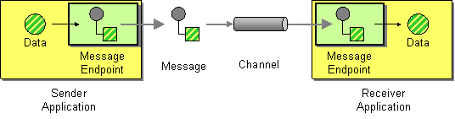
Message Endpoint
The Message Endpoint encapsulates the messaging system from the rest of the application and provide API to convert application data to messages and send to messaging system
Applications and massaging system connect to gather via End points
Message Endpoint code is custom to both the application and the messaging system’s client API
11 EIP related to Endpoints ( Messaging Gateway, Messaging Mapper, Transactional Client, Polling Consumer, Event-Driven Consumer, Competing Consumers, Message Dispatcher, Selective Consumer, Durable Subscriber, Idempotent Receiver, Service Activator)
Connect an application to a messaging channel using a Message Endpoint, a client of the messaging system that the application can then use to send or receive messages.
Notes:
This is a sample Picture with Caption slide ideal for including a picture with a brief descriptive statement.
To Replace the Picture on this Sample Slide (this applies to all slides in this template that contain replaceable pictures)
Select the sample picture and press Delete. Click the icon inside the shape to open the Insert Picture dialog box. Navigate to the location where the picture is stored, select desired picture and click on the Insert button to fit the image proportionally within the shape.
Note: Do not right-click the image to change the picture inside the picture placeholder. This will change the frame size of the picture placeholder. Instead, follow the steps outlined above.
Tip: use the Crop tool to reposition a picture within a placeholder. From the Picture Tools Format tab on the ribbon, click the Crop button. Click and drag the picture within the placeholder to reposition. To scale the picture within the placeholder (while Crop is active), grab a round corner handle and drag to resize. Hold Shift key to constrain picture aspect ratio when resizing.

Slide 10
System management
Messaging systems need to control and monitor the messages for administration purpose.
9 EIP related to System Management (Control Bus, System Management, Test Message, Detour, Wire Tap, Message History, Message Store, Smart Proxy, Test Message, Channel Purger)

Slide 11

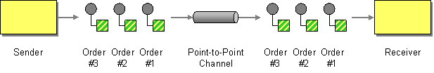
Point-to-Point Channel
A Point-to-Point Channel ensures that only one receiver consumes any given message.
If multiple receivers try to consume a single message, the channel ensures that only one of them succeeds, so the receivers do not have to coordinate with each other.
Send the message on a Point-to-Point Channel, which ensures that only one receiver will receive a particular message.
Notes:
This is a sample Picture with Caption slide ideal for including a picture with a brief descriptive statement.
To Replace the Picture on this Sample Slide (this applies to all slides in this template that contain replaceable pictures)
Select the sample picture and press Delete. Click the icon inside the shape to open the Insert Picture dialog box. Navigate to the location where the picture is stored, select desired picture and click on the Insert button to fit the image proportionally within the shape.
Note: Do not right-click the image to change the picture inside the picture placeholder. This will change the frame size of the picture placeholder. Instead, follow the steps outlined above.
Tip: use the Crop tool to reposition a picture within a placeholder. From the Picture Tools Format tab on the ribbon, click the Crop button. Click and drag the picture within the placeholder to reposition. To scale the picture within the placeholder (while Crop is active), grab a round corner handle and drag to resize. Hold Shift key to constrain picture aspect ratio when resizing.

Slide 12
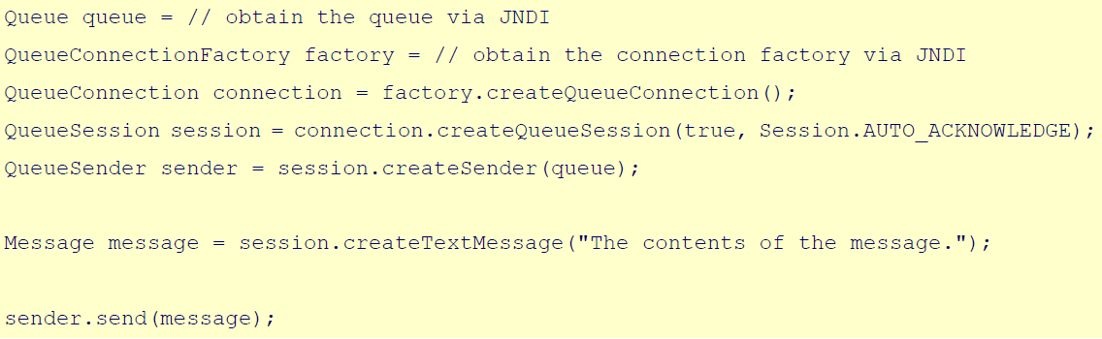
Point-to-Point Channel
This sample of sender made by JMS
Notes:
This is a sample Picture with Caption slide ideal for including a picture with a brief descriptive statement.
To Replace the Picture on this Sample Slide (this applies to all slides in this template that contain replaceable pictures)
Select the sample picture and press Delete. Click the icon inside the shape to open the Insert Picture dialog box. Navigate to the location where the picture is stored, select desired picture and click on the Insert button to fit the image proportionally within the shape.
Note: Do not right-click the image to change the picture inside the picture placeholder. This will change the frame size of the picture placeholder. Instead, follow the steps outlined above.
Tip: use the Crop tool to reposition a picture within a placeholder. From the Picture Tools Format tab on the ribbon, click the Crop button. Click and drag the picture within the placeholder to reposition. To scale the picture within the placeholder (while Crop is active), grab a round corner handle and drag to resize. Hold Shift key to constrain picture aspect ratio when resizing.

Slide 13
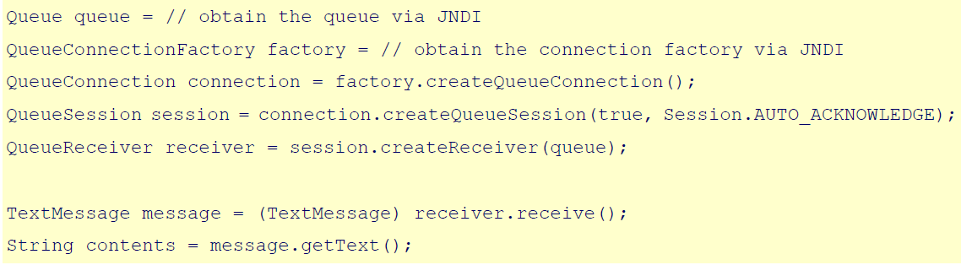
Point-to-Point Channel
This sample of reciever made by JMS
Send the message on a Point-to-Point Channel, which ensures that only one receiver will receive a particular message.
Notes:
This is a sample Picture with Caption slide ideal for including a picture with a brief descriptive statement.
To Replace the Picture on this Sample Slide (this applies to all slides in this template that contain replaceable pictures)
Select the sample picture and press Delete. Click the icon inside the shape to open the Insert Picture dialog box. Navigate to the location where the picture is stored, select desired picture and click on the Insert button to fit the image proportionally within the shape.
Note: Do not right-click the image to change the picture inside the picture placeholder. This will change the frame size of the picture placeholder. Instead, follow the steps outlined above.
Tip: use the Crop tool to reposition a picture within a placeholder. From the Picture Tools Format tab on the ribbon, click the Crop button. Click and drag the picture within the placeholder to reposition. To scale the picture within the placeholder (while Crop is active), grab a round corner handle and drag to resize. Hold Shift key to constrain picture aspect ratio when resizing.

Slide 14

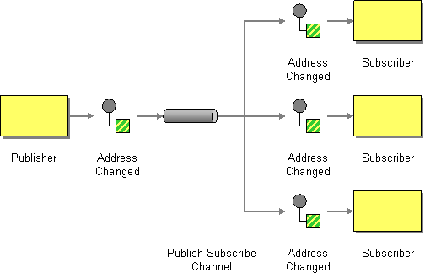
Publish-Subscribe Channel
A Publish-Subscribe Channel works like this: It has one input channel that splits into multiple output channels, one for each subscriber. When an event is published into the channel, the Publish-Subscribe Channel delivers a copy of the message to each of the output channels.
It looks like an Observer pattern
A Publish-Subscribe Channel can be a useful debugging tool. We can add extra subscriber for monitoring the message
Subscribing to a Message Channel is an operation that should be restricted by security policies.
Send the event on a Publish-Subscribe Channel, which delivers a copy of a particular event to each receiver.
Notes:
This is a sample Picture with Caption slide ideal for including a picture with a brief descriptive statement.
To Replace the Picture on this Sample Slide (this applies to all slides in this template that contain replaceable pictures)
Select the sample picture and press Delete. Click the icon inside the shape to open the Insert Picture dialog box. Navigate to the location where the picture is stored, select desired picture and click on the Insert button to fit the image proportionally within the shape.
Note: Do not right-click the image to change the picture inside the picture placeholder. This will change the frame size of the picture placeholder. Instead, follow the steps outlined above.
Tip: use the Crop tool to reposition a picture within a placeholder. From the Picture Tools Format tab on the ribbon, click the Crop button. Click and drag the picture within the placeholder to reposition. To scale the picture within the placeholder (while Crop is active), grab a round corner handle and drag to resize. Hold Shift key to constrain picture aspect ratio when resizing.

Slide 15
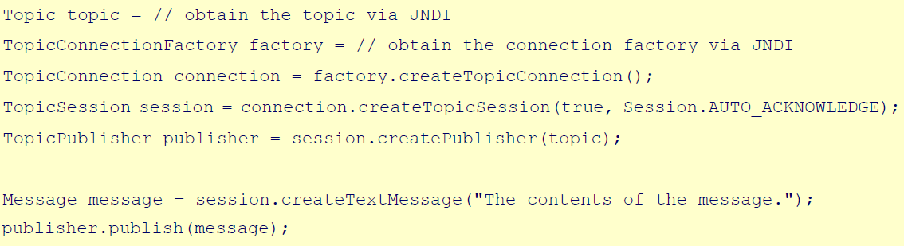
Publish-Subscribe Channel
Example of publisher in JMS
Notes:
This is a sample Picture with Caption slide ideal for including a picture with a brief descriptive statement.
To Replace the Picture on this Sample Slide (this applies to all slides in this template that contain replaceable pictures)
Select the sample picture and press Delete. Click the icon inside the shape to open the Insert Picture dialog box. Navigate to the location where the picture is stored, select desired picture and click on the Insert button to fit the image proportionally within the shape.
Note: Do not right-click the image to change the picture inside the picture placeholder. This will change the frame size of the picture placeholder. Instead, follow the steps outlined above.
Tip: use the Crop tool to reposition a picture within a placeholder. From the Picture Tools Format tab on the ribbon, click the Crop button. Click and drag the picture within the placeholder to reposition. To scale the picture within the placeholder (while Crop is active), grab a round corner handle and drag to resize. Hold Shift key to constrain picture aspect ratio when resizing.

Slide 16
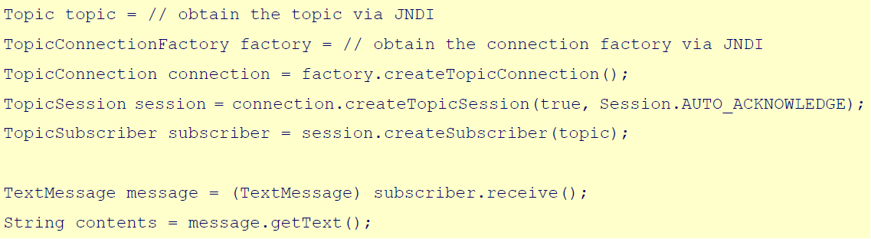
Publish-Subscribe Channel
Example of subscriber in JMS
Notes:
This is a sample Picture with Caption slide ideal for including a picture with a brief descriptive statement.
To Replace the Picture on this Sample Slide (this applies to all slides in this template that contain replaceable pictures)
Select the sample picture and press Delete. Click the icon inside the shape to open the Insert Picture dialog box. Navigate to the location where the picture is stored, select desired picture and click on the Insert button to fit the image proportionally within the shape.
Note: Do not right-click the image to change the picture inside the picture placeholder. This will change the frame size of the picture placeholder. Instead, follow the steps outlined above.
Tip: use the Crop tool to reposition a picture within a placeholder. From the Picture Tools Format tab on the ribbon, click the Crop button. Click and drag the picture within the placeholder to reposition. To scale the picture within the placeholder (while Crop is active), grab a round corner handle and drag to resize. Hold Shift key to constrain picture aspect ratio when resizing.

Slide 17

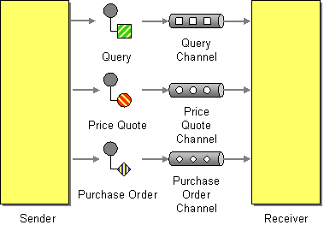
Datatype Channel
Datatype Channel is a channel that all messages inside with the same data type
Datatype Channel simplifies the proccing of the messages. It is like an Array with the same type in Programming language.
Each Channel in Message System reserves some resources from server so we can’t use this Pattern if we have a lot of message types.
Use a separate Datatype Channel for each data type, so that all data on a particular channel is of the same type.
Notes:
This is a sample Picture with Caption slide ideal for including a picture with a brief descriptive statement.
To Replace the Picture on this Sample Slide (this applies to all slides in this template that contain replaceable pictures)
Select the sample picture and press Delete. Click the icon inside the shape to open the Insert Picture dialog box. Navigate to the location where the picture is stored, select desired picture and click on the Insert button to fit the image proportionally within the shape.
Note: Do not right-click the image to change the picture inside the picture placeholder. This will change the frame size of the picture placeholder. Instead, follow the steps outlined above.
Tip: use the Crop tool to reposition a picture within a placeholder. From the Picture Tools Format tab on the ribbon, click the Crop button. Click and drag the picture within the placeholder to reposition. To scale the picture within the placeholder (while Crop is active), grab a round corner handle and drag to resize. Hold Shift key to constrain picture aspect ratio when resizing.

Slide 18

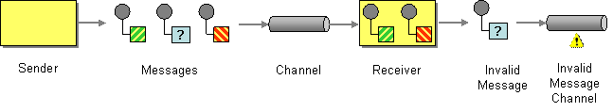
Invalid Message Channel
Invalid Message Channel stores improper messages that can’t parse by the application.
This channels is used in case of improper message not application error. For example in case of XML parsing problem or when header miss Message ID.
The receiver should move the improper message to an Invalid Message Channel, a special channel for messages that could not be processed by their receivers.
Notes:
This is a sample Picture with Caption slide ideal for including a picture with a brief descriptive statement.
To Replace the Picture on this Sample Slide (this applies to all slides in this template that contain replaceable pictures)
Select the sample picture and press Delete. Click the icon inside the shape to open the Insert Picture dialog box. Navigate to the location where the picture is stored, select desired picture and click on the Insert button to fit the image proportionally within the shape.
Note: Do not right-click the image to change the picture inside the picture placeholder. This will change the frame size of the picture placeholder. Instead, follow the steps outlined above.
Tip: use the Crop tool to reposition a picture within a placeholder. From the Picture Tools Format tab on the ribbon, click the Crop button. Click and drag the picture within the placeholder to reposition. To scale the picture within the placeholder (while Crop is active), grab a round corner handle and drag to resize. Hold Shift key to constrain picture aspect ratio when resizing.

Slide 19

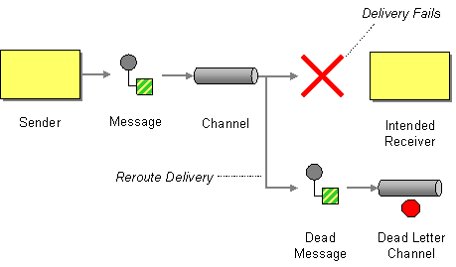
Dead Letter Channel
Dead Letter Channel stores messages that can’t be delivered by Messaging system itself.
Many result for sending Messages to Dead Letter Channel like Channel is deleted or message expires ,problem in message Header
This type of channel must be handle by messaging system not applicaiton
Notes:
This is a sample Picture with Caption slide ideal for including a picture with a brief descriptive statement.
To Replace the Picture on this Sample Slide (this applies to all slides in this template that contain replaceable pictures)
Select the sample picture and press Delete. Click the icon inside the shape to open the Insert Picture dialog box. Navigate to the location where the picture is stored, select desired picture and click on the Insert button to fit the image proportionally within the shape.
Note: Do not right-click the image to change the picture inside the picture placeholder. This will change the frame size of the picture placeholder. Instead, follow the steps outlined above.
Tip: use the Crop tool to reposition a picture within a placeholder. From the Picture Tools Format tab on the ribbon, click the Crop button. Click and drag the picture within the placeholder to reposition. To scale the picture within the placeholder (while Crop is active), grab a round corner handle and drag to resize. Hold Shift key to constrain picture aspect ratio when resizing.

Slide 20

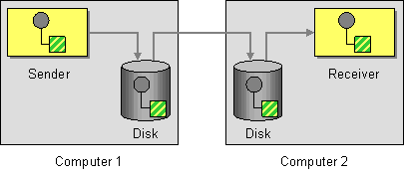
Guaranteed Delivery
One of main advantages of messaging system that It can guarantee delivery of the message after receiving it from sender.
Store and forward mechanism is an example of guarantee delivery implementation.
However, The default behavior of messaging system is to store the messages in the memory not in the disk . This default behavior can be changed.
The guarantee delivery decrease the performance and increase the price.
We can’t achieve 100% guaranteed Delivery.
Use Guaranteed Delivery to make messages persistent so that they are not lost even if the messaging system crashes.
Notes:
This is a sample Picture with Caption slide ideal for including a picture with a brief descriptive statement.
To Replace the Picture on this Sample Slide (this applies to all slides in this template that contain replaceable pictures)
Select the sample picture and press Delete. Click the icon inside the shape to open the Insert Picture dialog box. Navigate to the location where the picture is stored, select desired picture and click on the Insert button to fit the image proportionally within the shape.
Note: Do not right-click the image to change the picture inside the picture placeholder. This will change the frame size of the picture placeholder. Instead, follow the steps outlined above.
Tip: use the Crop tool to reposition a picture within a placeholder. From the Picture Tools Format tab on the ribbon, click the Crop button. Click and drag the picture within the placeholder to reposition. To scale the picture within the placeholder (while Crop is active), grab a round corner handle and drag to resize. Hold Shift key to constrain picture aspect ratio when resizing.

Slide 21
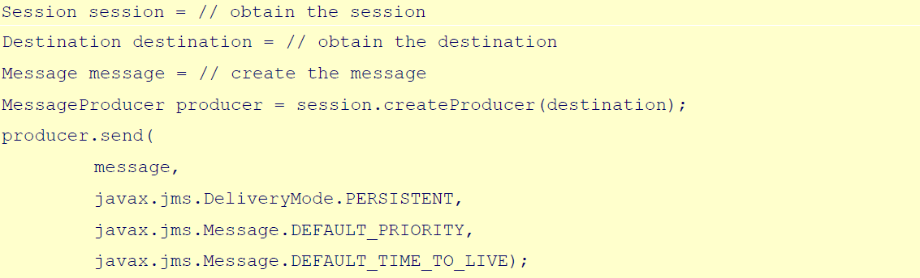
Guaranteed Delivery
Example of message persistent in JMS
Use Guaranteed Delivery to make messages persistent so that they are not lost even if the messaging system crashes.
Notes:
This is a sample Picture with Caption slide ideal for including a picture with a brief descriptive statement.
To Replace the Picture on this Sample Slide (this applies to all slides in this template that contain replaceable pictures)
Select the sample picture and press Delete. Click the icon inside the shape to open the Insert Picture dialog box. Navigate to the location where the picture is stored, select desired picture and click on the Insert button to fit the image proportionally within the shape.
Note: Do not right-click the image to change the picture inside the picture placeholder. This will change the frame size of the picture placeholder. Instead, follow the steps outlined above.
Tip: use the Crop tool to reposition a picture within a placeholder. From the Picture Tools Format tab on the ribbon, click the Crop button. Click and drag the picture within the placeholder to reposition. To scale the picture within the placeholder (while Crop is active), grab a round corner handle and drag to resize. Hold Shift key to constrain picture aspect ratio when resizing.

Slide 22

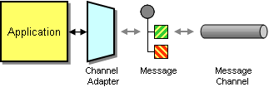
Channel Adapter
The adapter acts as a messaging client to the messaging system and invokes applications functions via an application-supplied interface.
Use a Channel Adapter that can access the application's API or data and publish messages on a channel based on this data, and that likewise can receive messages and invoke functionality inside the application.
Notes:
This is a sample Picture with Caption slide ideal for including a picture with a brief descriptive statement.
To Replace the Picture on this Sample Slide (this applies to all slides in this template that contain replaceable pictures)
Select the sample picture and press Delete. Click the icon inside the shape to open the Insert Picture dialog box. Navigate to the location where the picture is stored, select desired picture and click on the Insert button to fit the image proportionally within the shape.
Note: Do not right-click the image to change the picture inside the picture placeholder. This will change the frame size of the picture placeholder. Instead, follow the steps outlined above.
Tip: use the Crop tool to reposition a picture within a placeholder. From the Picture Tools Format tab on the ribbon, click the Crop button. Click and drag the picture within the placeholder to reposition. To scale the picture within the placeholder (while Crop is active), grab a round corner handle and drag to resize. Hold Shift key to constrain picture aspect ratio when resizing.

Slide 23
Channel Adapter
User interface adapter doesn’t need to access internal application but somehow slowdown the page render
Business Logic adapter is more efficient and encapsulate the system functionality . It is the better solution if the system provides good API
Database adapter: almost all applications uses Database which is dominated by few Vendors so it is suitable for legacy applications but require high knowledge of the system logic and process
There are general adapter such as and Internet-to-channel and SOAP to channel
Use a Channel Adapter that can access the application's API or data and publish messages on a channel based on this data, and that likewise can receive messages and invoke functionality inside the application.
Notes:
This is a sample Picture with Caption slide ideal for including a picture with a brief descriptive statement.
To Replace the Picture on this Sample Slide (this applies to all slides in this template that contain replaceable pictures)
Select the sample picture and press Delete. Click the icon inside the shape to open the Insert Picture dialog box. Navigate to the location where the picture is stored, select desired picture and click on the Insert button to fit the image proportionally within the shape.
Note: Do not right-click the image to change the picture inside the picture placeholder. This will change the frame size of the picture placeholder. Instead, follow the steps outlined above.
Tip: use the Crop tool to reposition a picture within a placeholder. From the Picture Tools Format tab on the ribbon, click the Crop button. Click and drag the picture within the placeholder to reposition. To scale the picture within the placeholder (while Crop is active), grab a round corner handle and drag to resize. Hold Shift key to constrain picture aspect ratio when resizing.

Slide 24

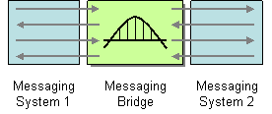
Messaging Bridge
In many case, we need to connect two messaging system . For example merging two enterprises , huge enterprise with many messaging system instance . B2B
There are no general solution to solve this issue
Many vendors provides there solution to connect message systems. Like SonicMQ connects MQSeries and TIBCO
The Messaging Bridge is a special adapter between two channels in different message system.
The bridge acts as map from one set of channels to the other, and also transforms the message format of one system to the other.
Use a Messaging Bridge, a connection between messaging systems, to replicate messages between systems
Notes:
This is a sample Picture with Caption slide ideal for including a picture with a brief descriptive statement.
To Replace the Picture on this Sample Slide (this applies to all slides in this template that contain replaceable pictures)
Select the sample picture and press Delete. Click the icon inside the shape to open the Insert Picture dialog box. Navigate to the location where the picture is stored, select desired picture and click on the Insert button to fit the image proportionally within the shape.
Note: Do not right-click the image to change the picture inside the picture placeholder. This will change the frame size of the picture placeholder. Instead, follow the steps outlined above.
Tip: use the Crop tool to reposition a picture within a placeholder. From the Picture Tools Format tab on the ribbon, click the Crop button. Click and drag the picture within the placeholder to reposition. To scale the picture within the placeholder (while Crop is active), grab a round corner handle and drag to resize. Hold Shift key to constrain picture aspect ratio when resizing.

Slide 25

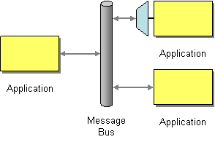
Message Bus
In the long run integration implementation inside Messaging system becomes complicated and hard maintained .
A Message Bus provides a common command set . If enterprise needs to implement more integration scenarios , it can use one or more commands of these command set
Basic pieces of Message bus
Common communication infrastructure ( message systems)
Adapters
Common Command Structure and common Data format
Structure the connecting middleware between these applications as a Message Bus that enables them to work together using messaging.
Notes:
This is a sample Picture with Caption slide ideal for including a picture with a brief descriptive statement.
To Replace the Picture on this Sample Slide (this applies to all slides in this template that contain replaceable pictures)
Select the sample picture and press Delete. Click the icon inside the shape to open the Insert Picture dialog box. Navigate to the location where the picture is stored, select desired picture and click on the Insert button to fit the image proportionally within the shape.
Note: Do not right-click the image to change the picture inside the picture placeholder. This will change the frame size of the picture placeholder. Instead, follow the steps outlined above.
Tip: use the Crop tool to reposition a picture within a placeholder. From the Picture Tools Format tab on the ribbon, click the Crop button. Click and drag the picture within the placeholder to reposition. To scale the picture within the placeholder (while Crop is active), grab a round corner handle and drag to resize. Hold Shift key to constrain picture aspect ratio when resizing.

Slide 26
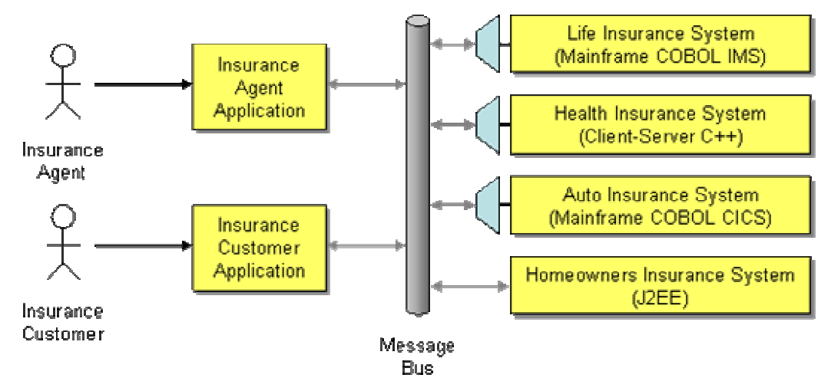
Message Bus
Insurance company buys a lot of products (life, Health, Auto, Home..) . Each product is handled by one application.
the company builds message bus that provides common set of command messages. For each products Message Bus provides ( Create , update, delete , read, getList) operations.
If we need to create a new application that provides report for insurance agent. We can create new operation that calls existing getList operations to get list of products and summarize the result.
Notes:
This is a sample Picture with Caption slide ideal for including a picture with a brief descriptive statement.
To Replace the Picture on this Sample Slide (this applies to all slides in this template that contain replaceable pictures)
Select the sample picture and press Delete. Click the icon inside the shape to open the Insert Picture dialog box. Navigate to the location where the picture is stored, select desired picture and click on the Insert button to fit the image proportionally within the shape.
Note: Do not right-click the image to change the picture inside the picture placeholder. This will change the frame size of the picture placeholder. Instead, follow the steps outlined above.
Tip: use the Crop tool to reposition a picture within a placeholder. From the Picture Tools Format tab on the ribbon, click the Crop button. Click and drag the picture within the placeholder to reposition. To scale the picture within the placeholder (while Crop is active), grab a round corner handle and drag to resize. Hold Shift key to constrain picture aspect ratio when resizing.

Slide 27
Thank you
Ayman.el-shayeb@hpe.com

